Slide 1


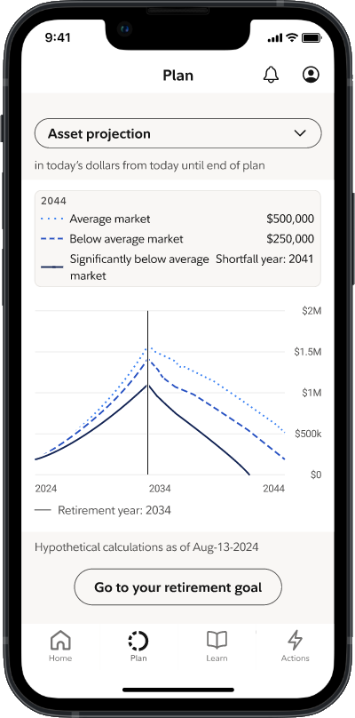
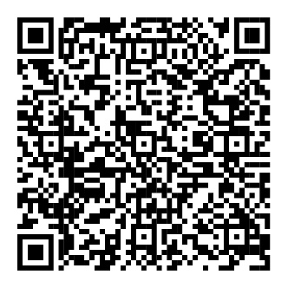


Take steps to save more.
Your Financial Wellness Dashboard on NetBenefits® has tools and educational resources to help you save for the unexpected and make progress toward your financial goals—during America Saves Week and all year long.
To view your dashboard, scan the code or visit NetBenefits.com/dashboard.
Screenshot is for illustrative purposes only.
The third-party trademarks and service marks appearing herein are the property of their respective owners. NetBenefits and the Fidelity Investments logo are registered service marks of FMR LLC.
Fidelity Brokerage Services LLC, Member NYSE, SIPC, 900 Salem Street, Smithfield, RI 02917
© 2026 FMR LLC. All rights reserved. 1246853.1.0

